Slide 1


Francisco Delgado López
6/6/2023

Slide 2
Outline
Executive Summary
Introduction
Methodology
Results
Conclusion

Slide 3
Executive Summary
Methodologies
Data collection through Application Program Interface (API) and
web scrapping.
Data wrangling
Exploratory Data Analysis with SQL and data visualization.
Interactive visual analytics with Folium.
Machine learning prediction.
Results
Exploratory Data Analysis results.
Interactive analytics.
Predictive analysis results.

Slide 4
Introduction
Project background and context
SpaceX advertises Falcon 9 rocket launches on its website with a cost of 62 million dollars; other providers cost upward of 165 million dollars each, much of the savings is because SpaceX can reuse the first stage. Therefore if we can determine if the first stage will land, we can determine the cost of a launch. This information can be used if an alternate company wants to bid against SpaceX for a rocket launch.
Problems you want to find answers
Can we predict if the Falcon 9 first stage will land successfully?
Can we determine the success rate of a successful landing?
Can we determine the operating conditions needed for a successful program?

Slide 5

Section 1

Slide 6
Methodology
Executive Summary
Data collection methodology:
Data was collected using Space X API and web scrapping from Wikipedia titled "List of Falcon 9 and Falcon heavy launces".
Perform data wrangling
Data was processed by cleaning the raw data, dealing with missing values, transformation of data types, size reduction, integration.
Perform exploratory data analysis (EDA) using visualization and SQL
Perform interactive visual analytics using Folium and Plotly Dash
Perform predictive analysis using classification models
How to build, tune, evaluate classification models

Slide 7
Data Collection
Data was collected through various methods:
Using get request to the SpaceX API,
Decoding content to JSON for turning it into a Pandas dataframe,
Cleaning the data (missing values, fill in values if necessary),
Using Beautiful Soup for web scrapping (Wikipedia),
Extracting launch records as HTML, parsing and converting into dataframe.

Slide 8

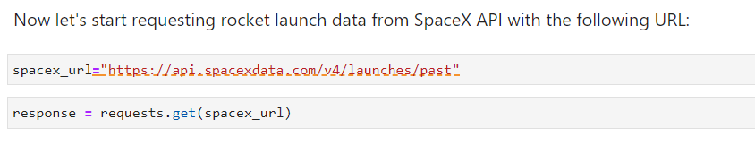
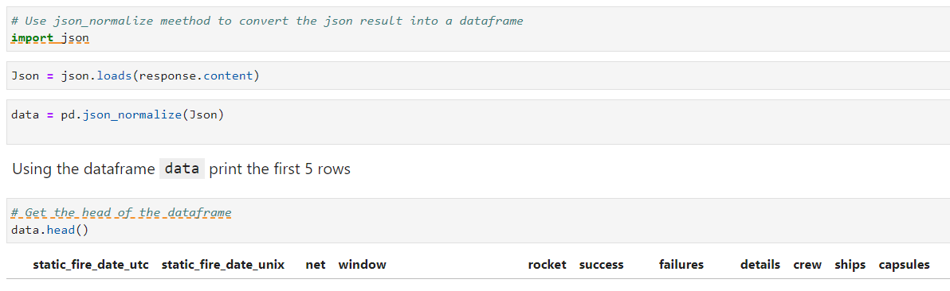
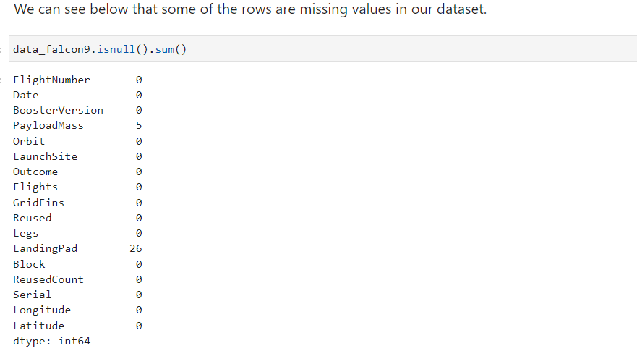
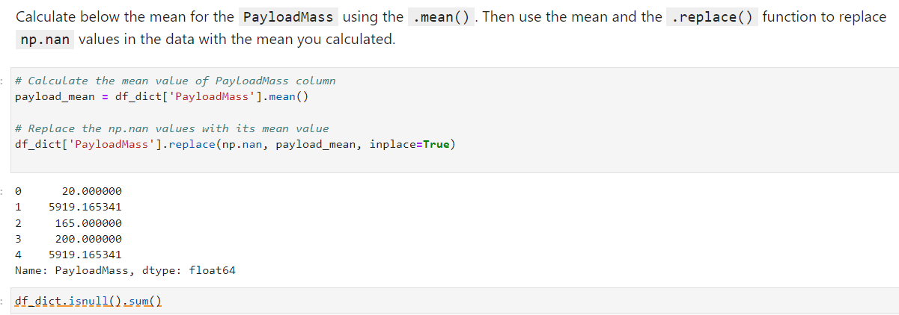
Data Collection – SpaceX API
Collection, data wrangling and cleaning were made by using libraries like requests, pandas, numpy, datetime, and their functions and methods. Link below is for the complete notebook.
https://github.com/FranDelgadoL/Applied-Data-Science-Capstone/blob/main/jupyter-labs-spacex-data-collection-api-FD.ipynb

Slide 9
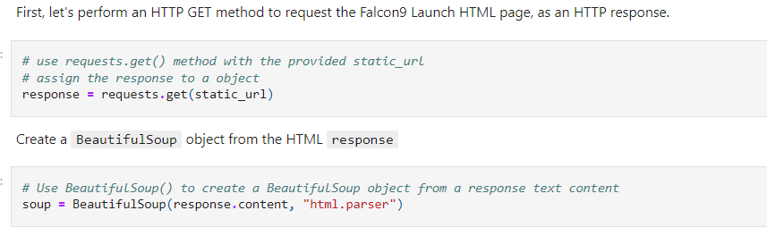
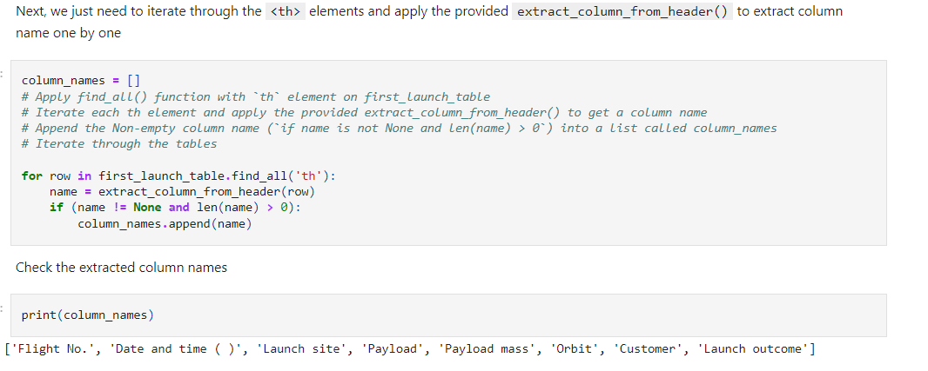
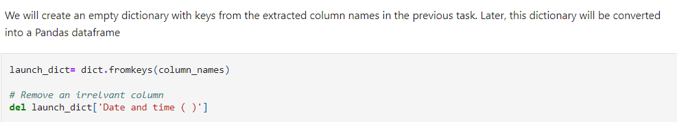
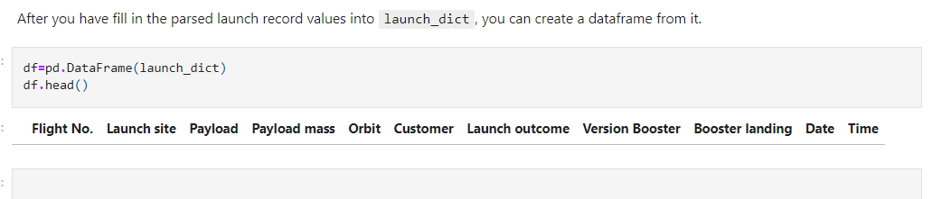
Data Collection - Scraping
We have made web scraping to Falcon 9 launch records (HTML) with BeautifulSoup package.
The table was parsed and converted to a pandas dataframe. Below you can see the whole process.
https://github.com/FranDelgadoL/Applied-Data-Science-Capstone/blob/main/jupyter-labs-webscraping-FD.ipynb

Slide 10
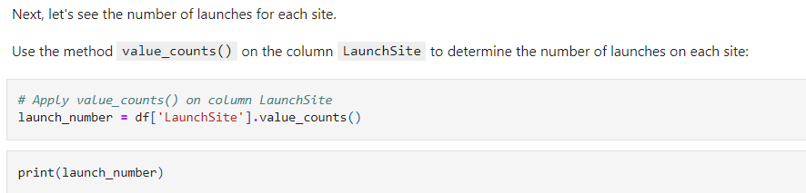
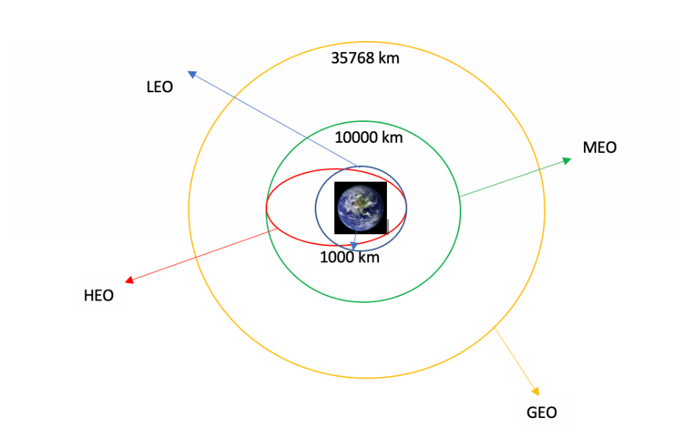
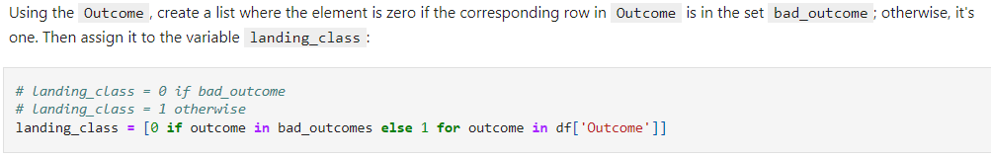
Data Wrangling
We performed exploratory data analysis and determined training labels.
We calculated the number of launches on each site, occurrence of each orbit, occurrence of mission outcome and created a landing outcome.
Here you can see the whole process: https://github.com/FranDelgadoL/Applied-Data-Science-Capstone/blob/main/labs-jupyter-spacex-data_wrangling_jupyterlite.jupyterlite.ipynb

Slide 11
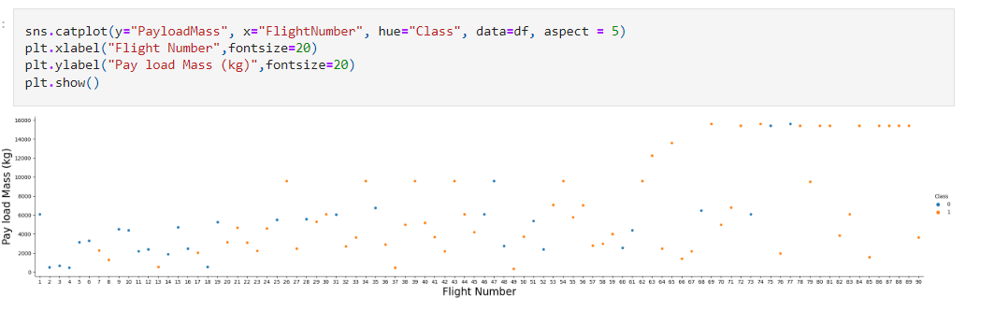
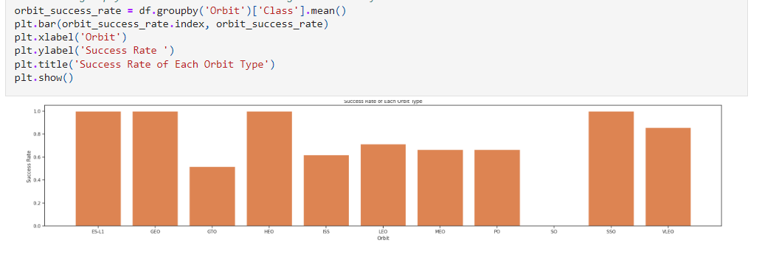
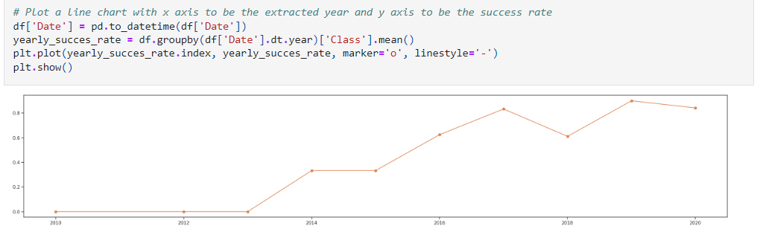
EDA with Data Visualization
Data was explored by visualizing the relationship between flight number and launch site, payload and launch site, success rate, flight number and orbit type, payload and orbit type and launch success yearly trend. Libraries used: Matplotlib and Seaborn.
We used scatter plot because it is better for visualizing patterns, trends or correlations. Bar charts for categorical data. Line charts better represent trends and changes over time.
Here you can see the whole plotting process: https://github.com/FranDelgadoL/Applied-Data-Science-Capstone/blob/main/jupyter-labs-eda-dataviz.ipynb.jupyterlite.ipynb

Slide 12
EDA with SQL
Next, we can show a summary of SQL queries performed:
SELECT * FROM WHERE LIKE ' ' LIMIT 5; to display 5 records where launch sites begin with the string 'CCA'
SELECT SUM() FROM WHERE ; to display the total payload mass carried by boosters launched by NASA (CRS)
SELECT AVG() FROM WHERE ; to display average payload mass carried by booster version F9 v1.1
SELECT MIN() FROM WHERE; to list the date when the first successful landing outcome in ground pad was achieved.
SELECT FROM WHERE = ' ' AND > AND …. < ; to list the names of the boosters which have success in drone ship and have payload mass greater than 4000 but less than 6000.
SELECT FROM WHERE = ( SELECT MAX() FROM ); to list the names of the booster_versions which have carried the maximum payload mass, using subquery.
SELECT FROM WHERE … = ... 'Failure (drone ship)' and YEAR(Date) = 2015; to list the records which will display the month names, failure landing_outcomes in drone ship ,booster versions, launch_site for the months in year 2015.
SELECT COUNT (*) FROM WHERE AND LIKE 'Success%' GROUP BY ORDER BY DESC; to rank the count of successful landing_outcomes between the date 04-06-2010 and 20-03-2017 in descending order.
Here you can get the notebook: https://github.com/FranDelgadoL/Applied-Data-Science-Capstone/blob/main/jupyter-labs-eda-sql-coursera_sqllite.ipynb

Slide 13
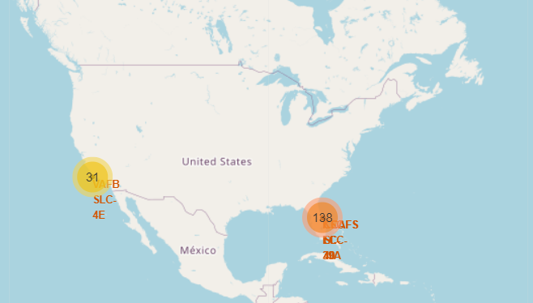
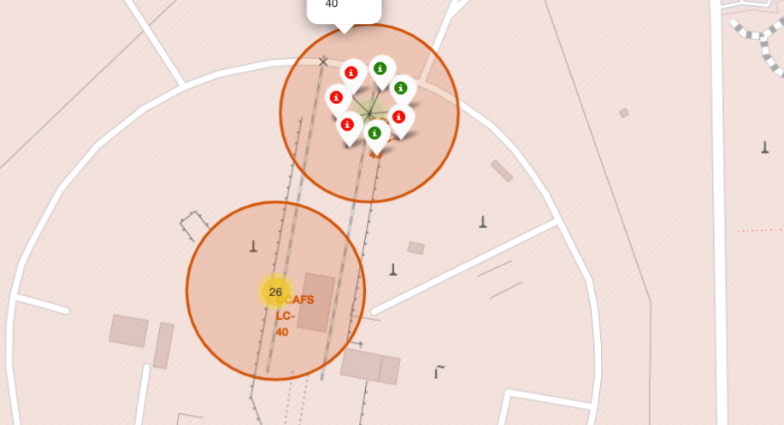
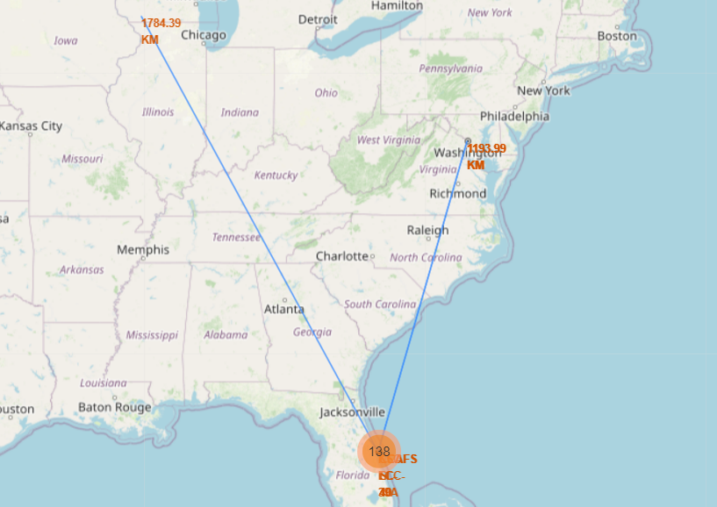
Build an Interactive Map with Folium
We performed interactive visual analytics using Folium. We needed to create map, circle and marker objects to add to a Folium objects.
We first created a folium map object, with an initial center location and then a circle and a marker object to highlight the area with a text label and an icon for it, respectively.
Next, we created markers for all launch records. For successful (class=1), we used a green marker and for failed (class=0), we used a red marker.
We wanted to experiment with calculating the distance between launch site and a highway and a city. They are very far away from the launch site (Arlington Boulevard, VA; Darlington City, WI) . We have drawn a line between the marker to the launch site.
https://github.com/FranDelgadoL/Applied-Data-Science-Capstone/blob/main/lab_jupyter_launch_site_location.jupyterlite.ipynb

Slide 14
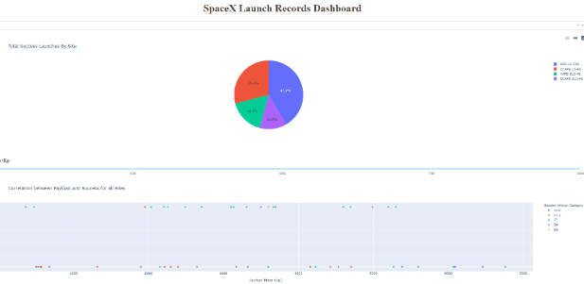
Build a Dashboard with Plotly Dash
We have used Plotly Dash for interactive dashboard.
We added pie chart to show the total successful launches count for all sites
Add a slider to select payload range.
Add a scatter chart to show the correlation between payload and launch success.
https://github.com/FranDelgadoL/Applied-Data-Science-Capstone/blob/main/spacex_dash_app.py

Slide 15
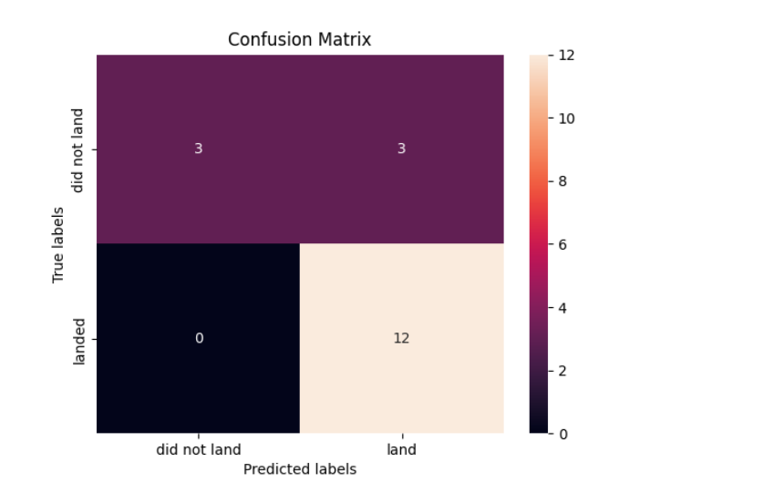
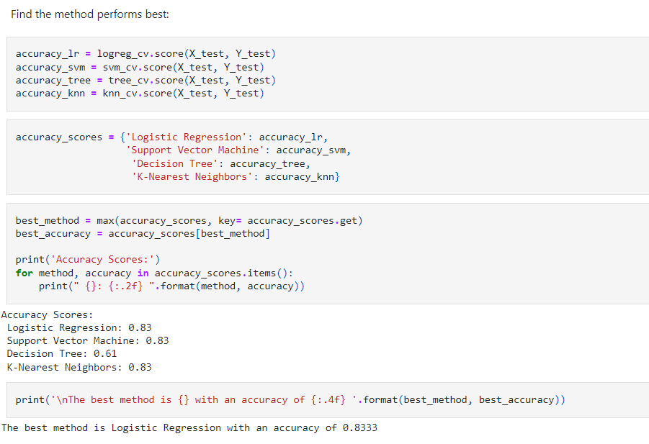
Predictive Analysis (Classification)
We performed exploratory data analysis and determined training labels using numpy, pandas, seaborn, matplotlib, scikitlearn.
Having the data loaded, we created a column for the class, standardize the data, split into training data and test data. Also, we used a confusion matrix to evaluate the performances.
Logistic Regression, Support Vector Machine, Decision Tree and K-Nearest Neighbors were the four methods for training and testing our model, using GridSearchCV.
Then we evaluated and find the best performing classification model through comparison between their accuracy scores.
https://github.com/FranDelgadoL/Applied-Data-Science-Capstone/blob/main/SpaceX_Machine_Learning_Prediction_Part_5.jupyterlite%20(1)%20(1).ipynb

Slide 16
Results
Exploratory data analysis results
Interactive analytics demo in screenshots
Predictive analysis results

Slide 17

Section 2

Slide 18
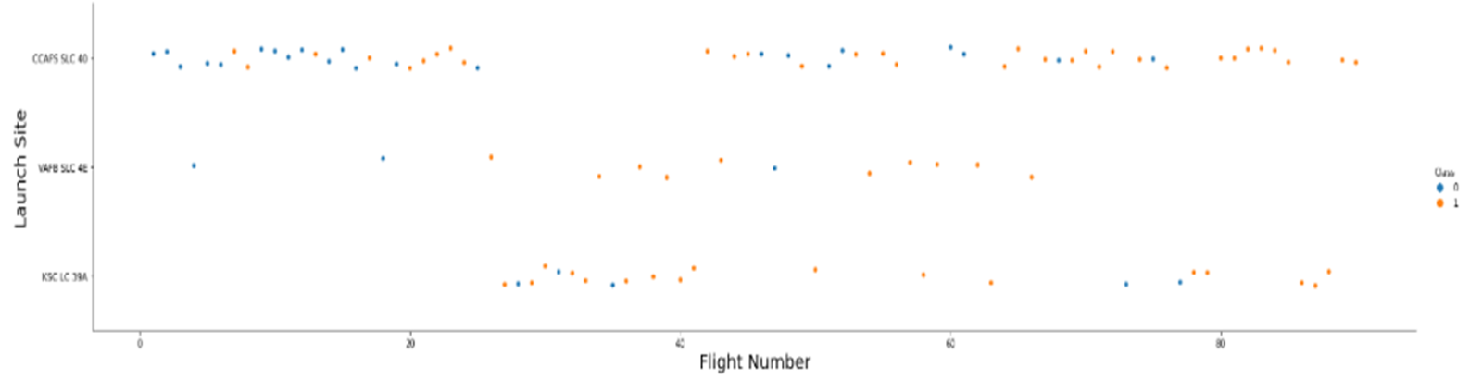
Flight Number vs. Launch Site
We can see that that the larger number of flights in a launch site, give a better success rate to that launch site, comparing to the other sites.

Slide 19
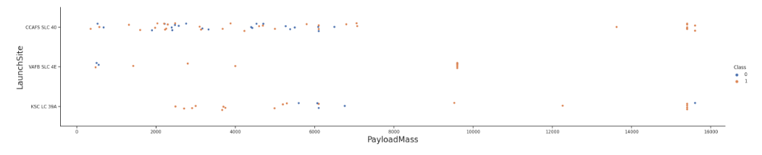
Payload vs. Launch Site
We can see that the more payload a rocket has, the more successful it will be in its performance.

Slide 20
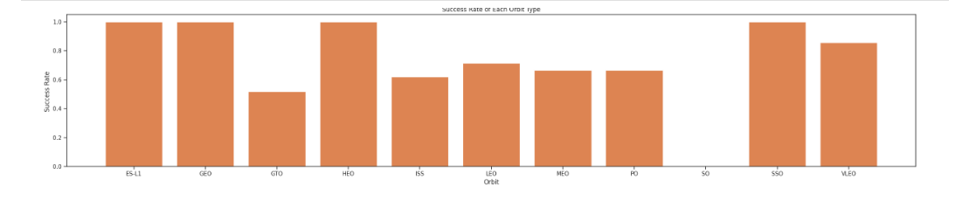
Success Rate vs. Orbit Type
Clearly the four best performances go to ES-L1, GEO, HEO, SSO. The orbit VLEO is the next best success rate but still a little far from the others.

Slide 21
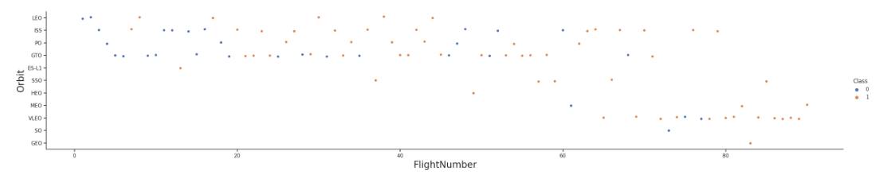
Flight Number vs. Orbit Type
We can see that in LEO orbit the success appears to the number of flights, while in GTO there is no relations between number of flights and success.

Slide 22
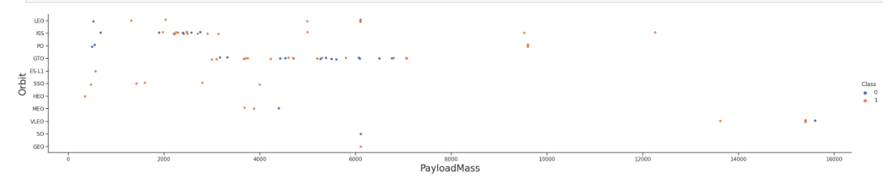
Payload vs. Orbit Type
This plot shows us that with heavy payloads the positive landing rate goes for PO, LEO and ISS orbits.

Slide 23
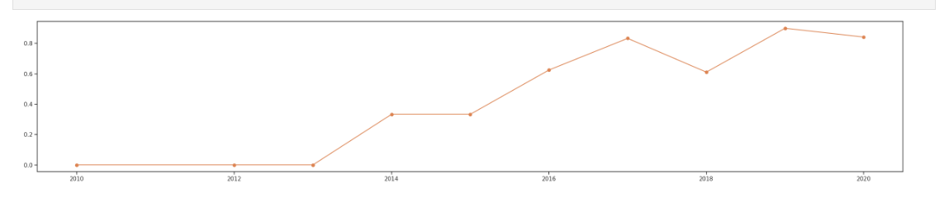
Launch Success Yearly Trend
This plot shows us that success rate kept increasing from year 2013 till 2020.

Slide 24
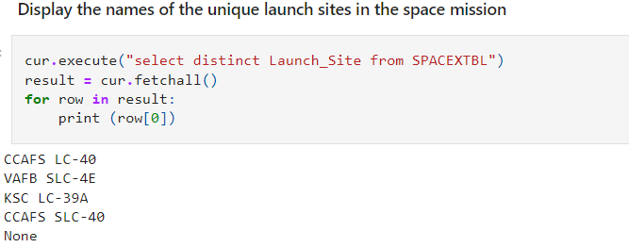
All Launch Site Names
We applied cur.execute method for this DQL statement to retrieve the names of the unique launch sites in this space mission.

Slide 25
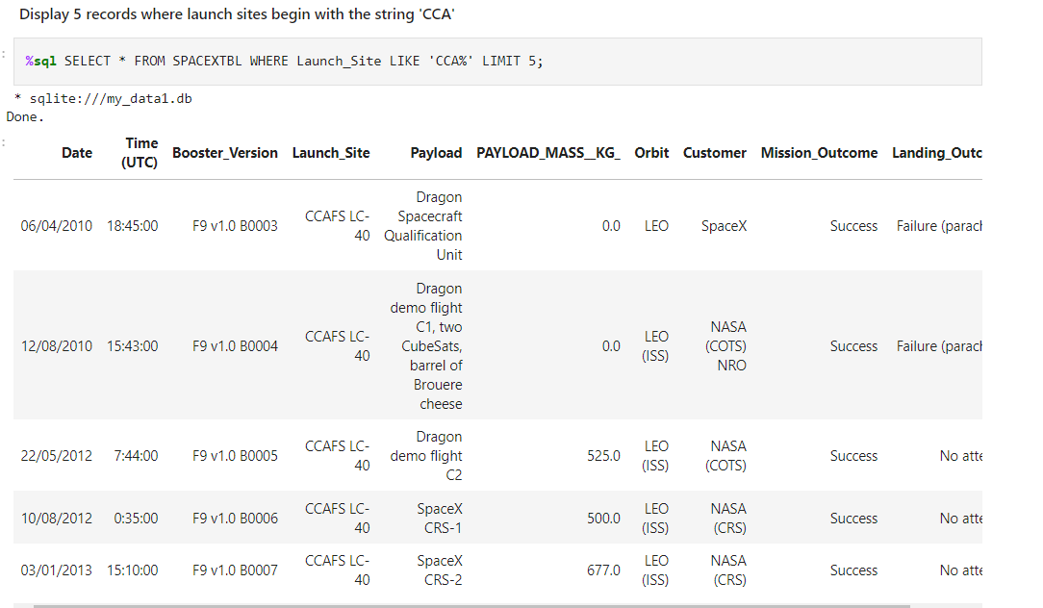
Launch Site Names Begin with 'CCA'
The query above retrieved us 5 records where launch site begins with 'CCA'

Slide 26
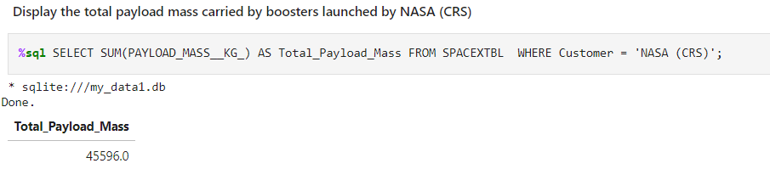
Total Payload Mass
We used SELECT SUM from the table SPACEXTBL to retrieve total payload mass carried by boosters by NASA.

Slide 27
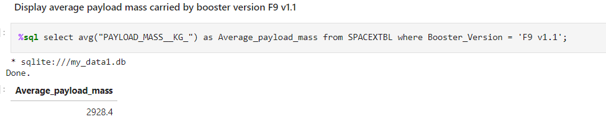
Average Payload Mass by F9 v1.1
We used the SELECT AVG sql query to retrieve the payload mass of booster version F9 v1.1

Slide 28
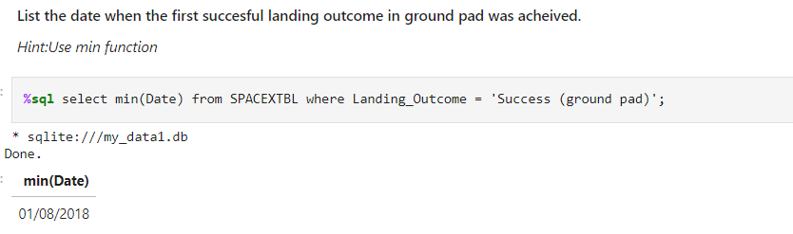
First Successful Ground Landing Date
We used SELECT MIN() function to get the first successful ground landing date.

Slide 29
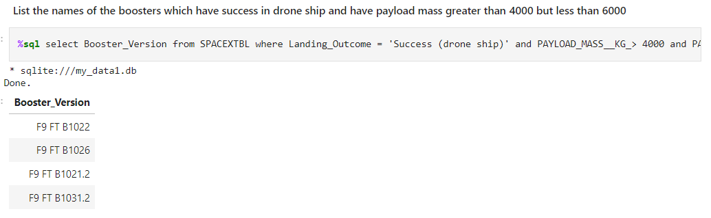
Successful Drone Ship Landing with Payload between 4000 and 6000
The query above is to get the successful drone shiop landing with the requested payload range.

Slide 30
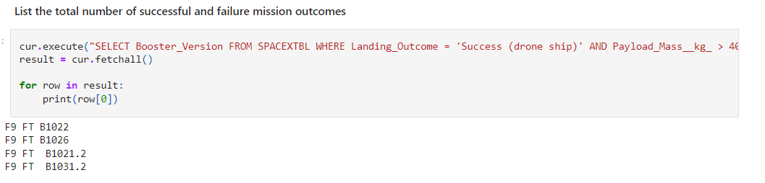
Total Number of Successful and Failure Mission Outcomes
Cur.execute method was used here to retrieve the total number of seuccessful and dailure missions.

Slide 31
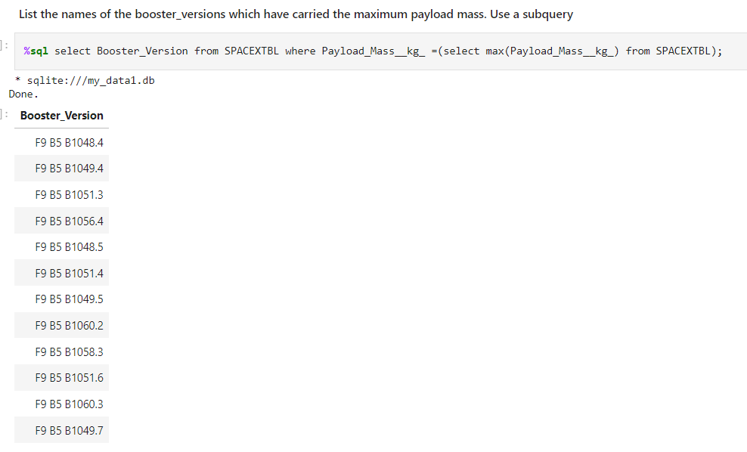
Boosters Carried Maximum Payload
Maximum payload mass boosters were retrieved in the query shown above.

Slide 32
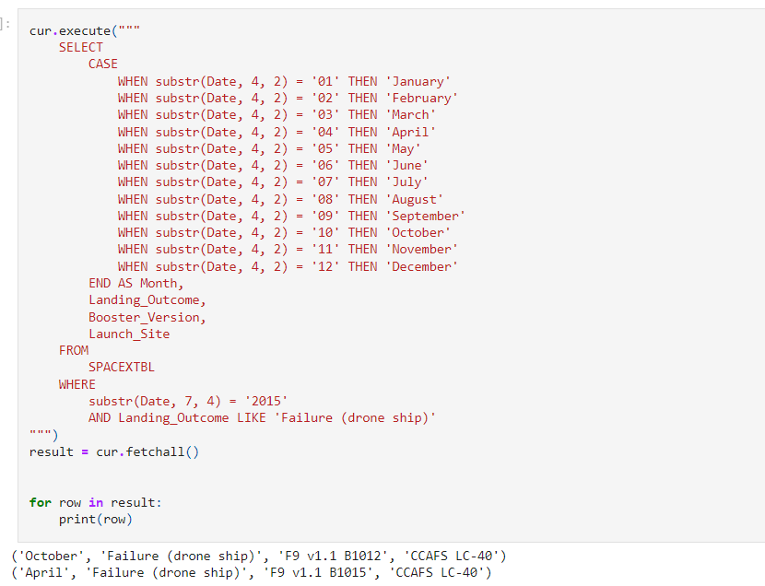
2015 Launch Records
Since sqlite doesn't support monthnames, we needed to use substr(Date,4,2) as month to get the months and substr(Date,7,4) = '2015' to get for year. Cur.execute method was used.

Slide 33
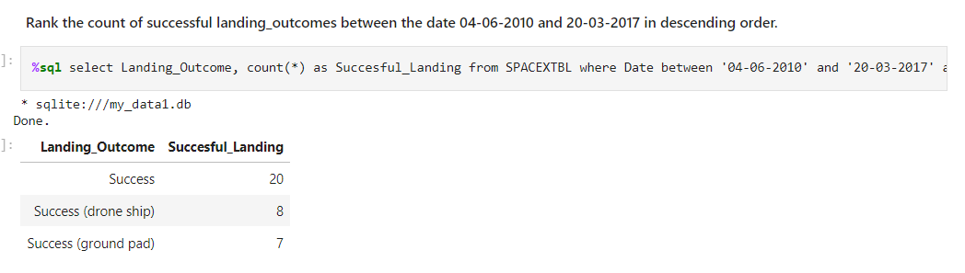
Rank Landing Outcomes Between 2010-06-04 and 2017-03-20
The query above is to retrieve a rank for successful landings between the given range of time.

Slide 34

Section 3

Slide 35
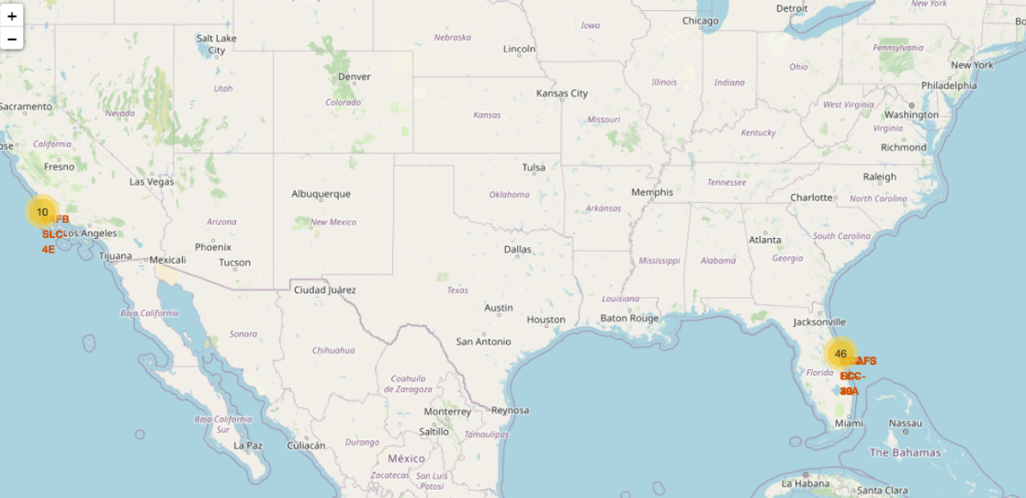
Locations of all launch sites.
United State's geographical map is shown here with the locations of the launch sites and we can see all of them are located on both coasts, east and west, of the country. Specifically in Florida and California.

Slide 36
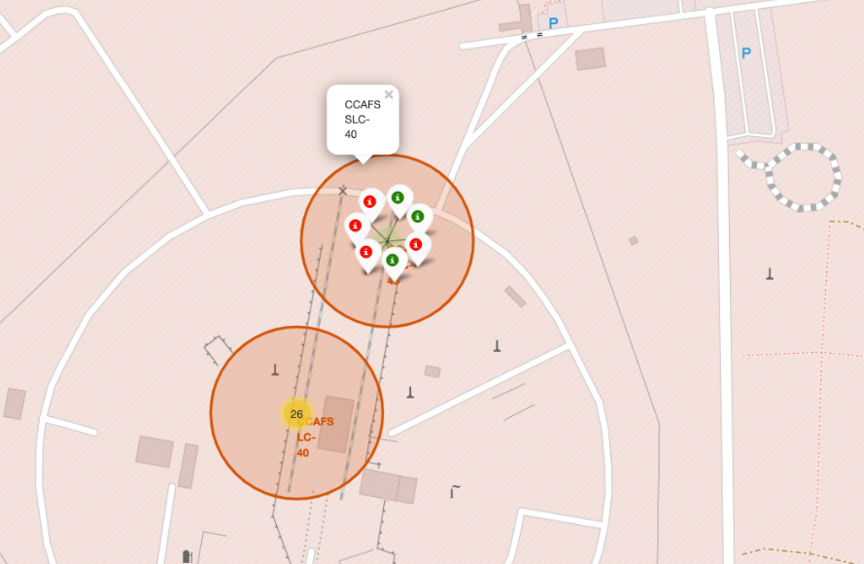
Launch sites with color labeled markers.
Here is an example showing us markers of launch sites locations and their performances. Green is for successful and red is for failure.

Slide 37
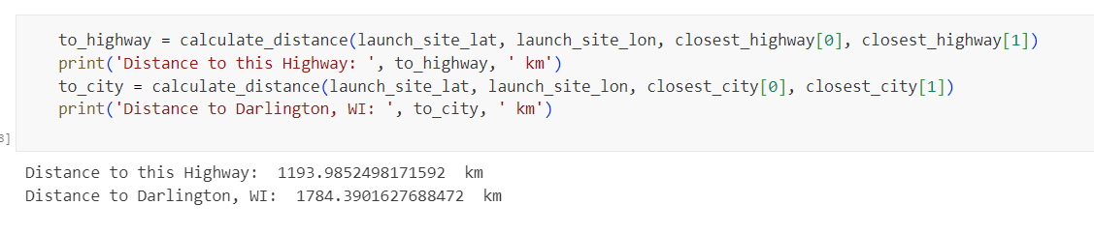
Distance from selected highway and city.
The selected highqay and city is not from the original task. I made this decision by my own because I wanted to know the distance from Florida launch site to my sister's city in Wisconsin and a highway near my aunt's house in Arlington, Virginia.
Arlington highway is 1194km from this launch site and Darlington City is 1784km far from it.

Slide 38

Section 4

Slide 39
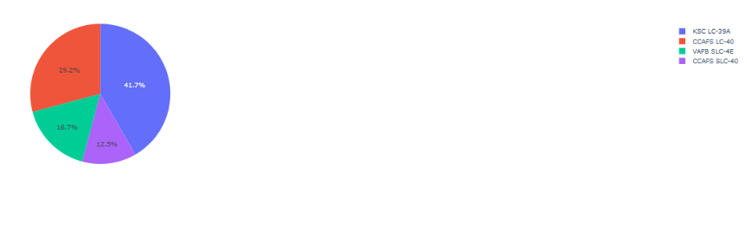
Percentage successful rate of launch sites.
This plot shows us that KSC-LC39A has most of the successful rate among others, with almost 42%.

Slide 40
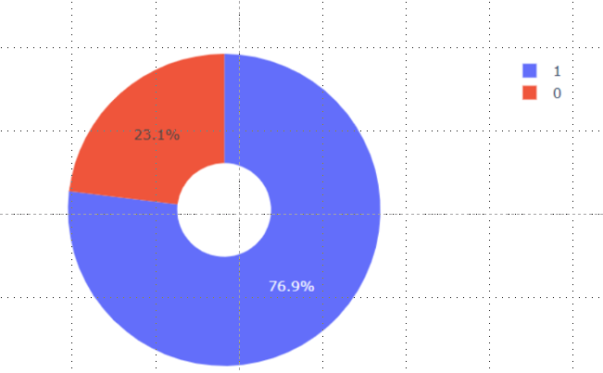
Piechart for the launch site with highest launch success ratio
KSC-LC39A records a 23,1% of failure versus almost 77% of success. It is the most successful launch site in this case.

Slide 41

Section 5

Slide 42
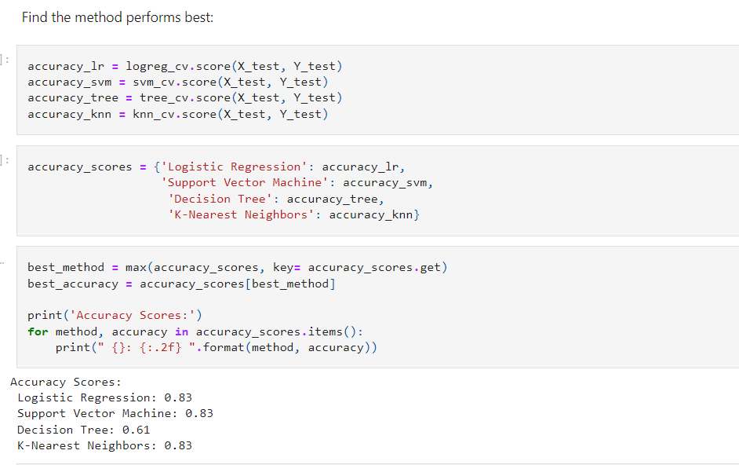
Classification Accuracy
Logistic regression has the vest performance conparing to others, but ther is a minimun gap between them.

Slide 43
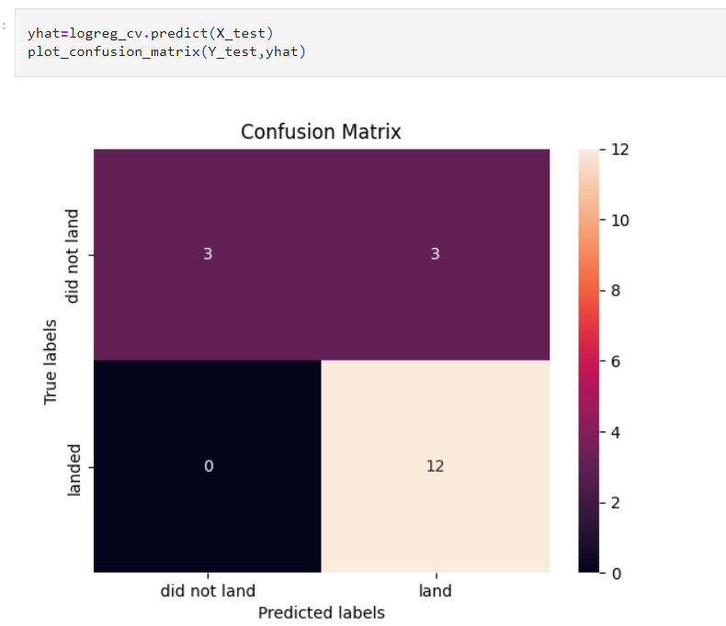
Confusion Matrix
This is the confussion matriz for Logistic regression, we can see false positives in the matrix.

Slide 44
Conclusions
The success rate in a launch site is higher when the amount of flight numbers is higher.
From year 2013 launch success rate kept increasing until year 2020.
KSC-LC29A has the most successful rate among other launch sites.
Best performances go to ES-L1, GEO, HEO, SSO. The orbit VLEO is the next best success rate but still a little far from the others.
Logistic Regression is the best machine learning algorithm in this case.

Slide 45


